Slide 1
Unit Test Vue.js with Karma & Mocha
by WANZARGEN

Slide 2
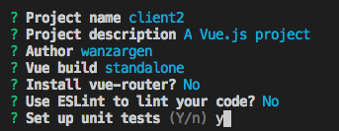

Vue CLI를 이용한 세팅
Notes:
cross-env BABEL_ENV=test karma start test/unit/karma.conf.js --single-run

Slide 3
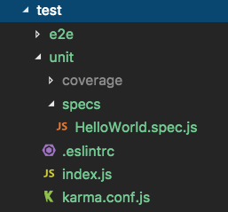
Test folder structure

Slide 4
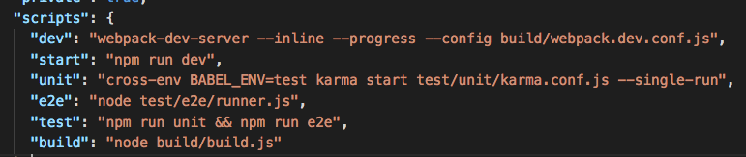

Run unit test
package.json

Slide 5
karma.conf.js
config.set({
browsers: ['PhantomJS'],
frameworks: ['mocha', 'sinon-chai', 'phantomjs-shim'],
reporters: ['spec', 'coverage'],
files: ['./index.js'],
preprocessors: {
'./index.js': ['webpack', 'sourcemap']
}
webpack: webpackConfig,// NODE_ENV: '"testing"' webpackMiddleware: {
noInfo: true
},
coverageReporter: {
dir: './coverage',
reporters: [
{ type: 'lcov', subdir: '.' },
{ type: 'text-summary' }
]
}
})
Notes:
Mocha allows you to use any assertion library you wish.
https://mochajs.org/
<assertion>
Sinon–Chai provides a set of custom assertions for using the Sinon.JS spy, stub, and mocking framework with the Chai assertion library. You get all the benefits of Chai with all the powerful tools of Sinon.JS.

Slide 6
index.js
import Vue from 'vue'
Vue.config.productionTip = false
// require all test files (files that ends with .spec.js)
const testsContext = require.context('./specs', true, /\.spec$/)
testsContext.keys().forEach(testsContext)
// require all src files except main.js for coverage.
// you can also change this to match only the subset of files that
// you want coverage for.
const srcContext = require.context('../../src', true, /^\.\/(?!main(\.js)?$)/)
srcContext.keys().forEach(srcContext)

Slide 7
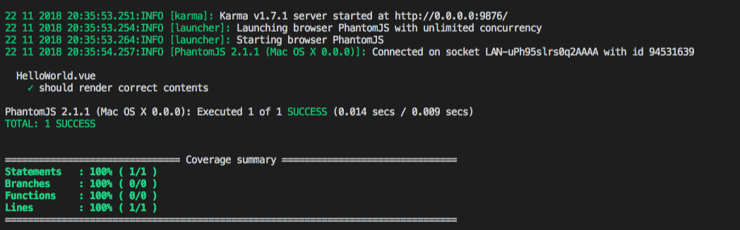
Unit Test Result

Slide 8
HelloWorld.spec.js
import Vue from 'vue'
import HelloWorld from '@/components/HelloWorld'
describe('HelloWorld.vue', () => {
it('should render correct contents', () => {
const Constructor = Vue.extend(HelloWorld)
const vm = new Constructor().$mount()
expect(vm.$el.querySelector('.hello h1').textContent)
.to.equal('Welcome to Your Vue.js App')
})
})

Slide 9
Specs
A spec contains one or more expectations that test the state of the code.
An expectation in Jasmine is an assertion that is either true or false.
A spec with all true expectations is a passing spec.
A spec with one or more false expectations is a failing spec.

Slide 10
Grammar
Since describe and it blocks are functions, they can contain any executable code necessary to implement the test.
JavaScript scoping rules apply, so variables declared in a describe are available to any it block inside the suite.
describe('HelloWorld.vue', () => {
it('should render correct contents', () => {
...
})
})

Slide 11
Grammar - chai
Expectation 문은 실제값을 취하는 expect 함수로 작성
기대 값(예상 값)을 가지는 Matcher function 들과 연결됨(chained)
각 chain들은 실제 값과 예상 값을 비교 -> report boolean 값 to mocha
var a = 12;
expect(a).to.equal(12);
expect(true).to.be(true);
expect(false).to.not.be(true);
var message = "foo bar baz";
expect(message).to.match(/bar/);
expect(message).to.match("bar"); expect(message).to.not.match(/quux/);
Chai grammar =>
Notes:
Chai - expect(), assert() and should-style assertions

Slide 12
Grammar
HelloWorld.vue
HelloWorld.spec.js
<template>
<div class="hello">
<h1>{{ msg }}</h1>
</div>
</template>
<script>
export default {
name: 'HelloWorld',
data () {
return {
msg: 'Welcome to Your Vue.js App'
}
}
}
</script>
<style scoped> </style>
const Constructor = Vue.extend(HelloWorld)
// Vue를 상속받는 하위 클래스를 만듦
const vm = new Constructor().$mount()
//인스턴스를 만들고, 엘리먼트에 마운트함
expect(vm.$el.querySelector('.hello h1')
.textContent)
.to.equal('Welcome to Your Vue.js App')
Notes:
Vue 인스턴스가 인스턴스화 할 때 el 옵션이 없으면 연결된 DOM 엘리먼트 없이 “unmounted” 상태가 됨. vm.$mount()는 unmounted 된 Vue인스턴스의 마운트를 수동으로 시작하는데 사용
인스턴스가 마운트 된 이후, 그 엘리먼트는 vm.$el로 액세스 가능
*mount: adding nodes to the DOM
*unmount: removing them from the DOM
*updating: making changes to nodes already in the DOM

